Slide 1

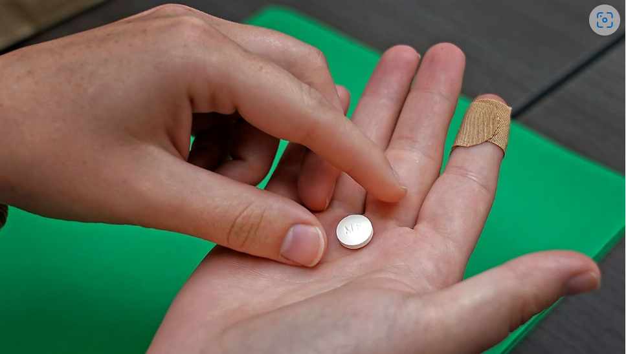
FDA DRUG Recalls
Chris Garcia-Salinas
Alyssandra Calhoun
Sabrina Maritn
Hunter Banda
Lakshmi Adithya

Slide 2
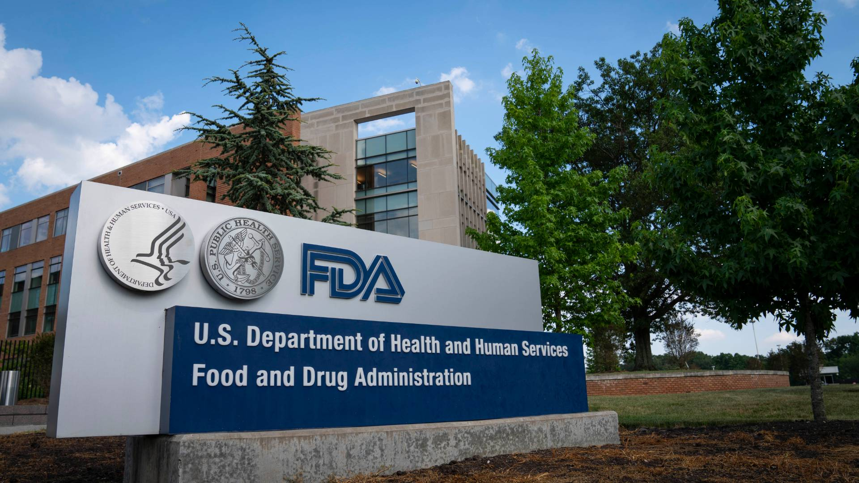
What does the FDA stand for & what do they do?
FDA stands for Food and Drug Administration
FDA is a US government agency assigned to protect public health

Slide 3
The different classifications for drugs in the FDA
Class I
Dangerous or defective products that predictably could cause serious health problems or death.
Class II
Products that might cause a temporary health problem or pose only a slight threat of a serious nature.
Class III
Products that are unlikely to cause any adverse health reaction but violate FDA labeling or manufacturing laws.

Slide 4

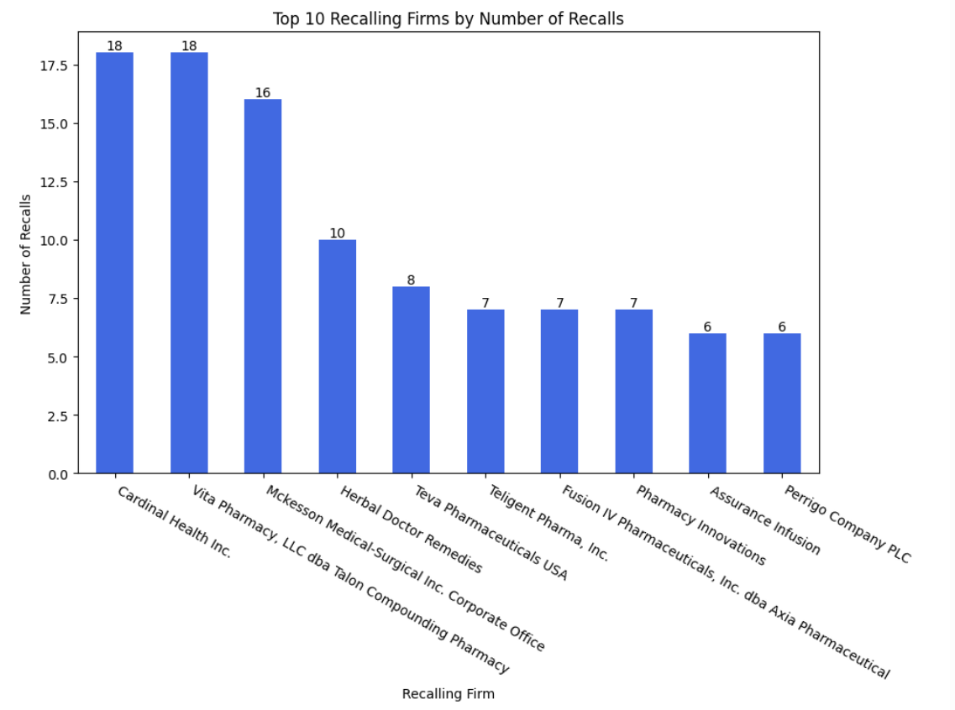
Which firms had the most recalls?
Recalling Firm Cardinal Health Inc. 18 Vita Pharmacy, LLC dba Talon Compounding Pharmacy 18 Mckesson Medical-Surgical Inc. Corporate Office 16 Herbal Doctor Remedies 10 Teva Pharmaceuticals USA 8 Teligent Pharma, Inc. 7 Fusion IV Pharmaceuticals, Inc. dba Axia Pharmaceutical 7 Pharmacy Innovations 7 Perrigo Company PLC 6 Accord Healthcare, Inc. 6
Recalling Firm Cardinal Health Inc. 18 Vita Pharmacy, LLC dba Talon Compounding Pharmacy 18 Mckesson Medical-Surgical Inc. Corporate Office 16 Herbal Doctor Remedies 10 Teva Pharmaceuticals USA 8 Teligent Pharma, Inc. 7 Fusion IV Pharmaceuticals, Inc. dba Axia Pharmaceutical 7 Pharmacy Innovations 7 Perrigo Company PLC 6 Accord Healthcare, Inc. 6

Slide 5
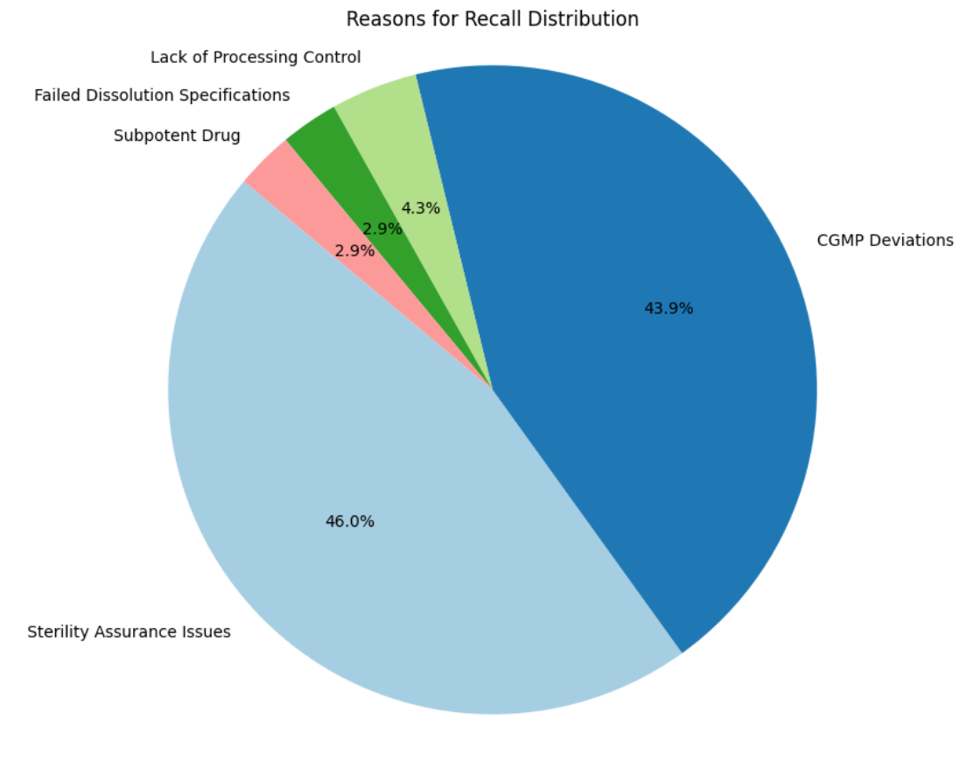

Slide 6
TYPE OF MEDICATIONS RECALLED MOST FREQUENTLY
Commonly recalled medications include:
Oxycodone
Methadone
Adderall
Meperidine
Hydromorphone
These medications are typically prescribed for:
Severe pain management
Anxiety treatment
Insomnia relief
Attention Deficit Hyperactivity Disorder (ADHD)

Slide 7
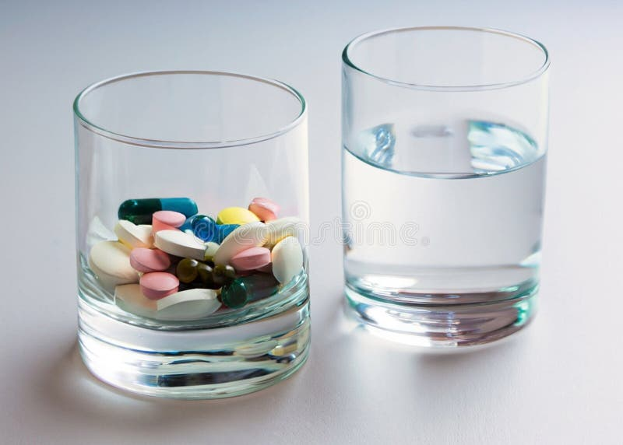
Why class ii drugs dominate OVERALL recalls
Class II drugs are recalled more often because even though they pose moderate health risks, they’re not immediately life-threatening.
Their large-scale production raises the probability of issues like contamination or mislabeling.
Even minor quality concerns in such widely prescribed drugs trigger recalls, reflecting the FDA’s strict standards to keep patients safe

Slide 8
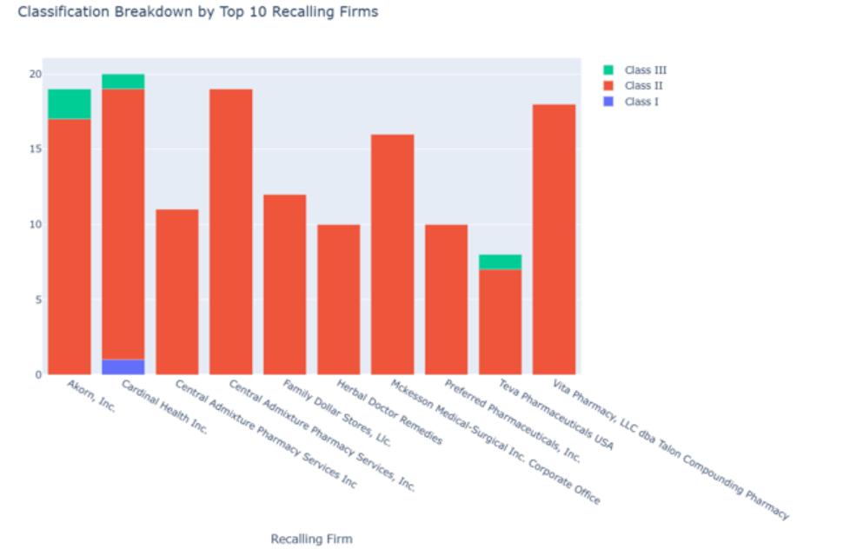
Classification Breakdown by Top 10 Recalling Firms

Slide 9
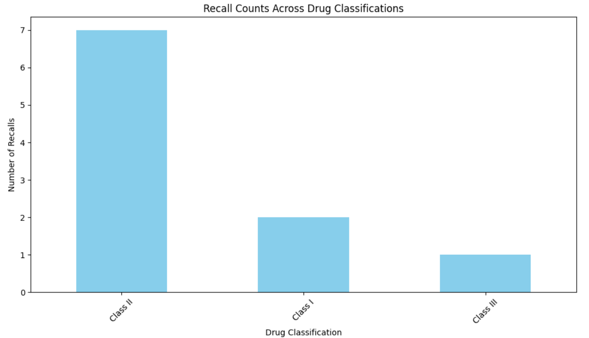

Slide 10
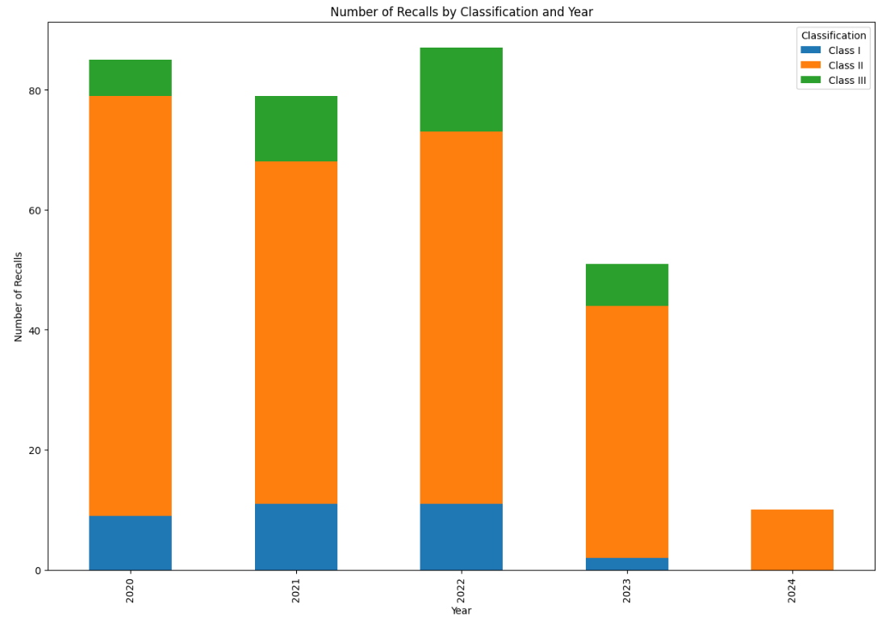

Slide 11
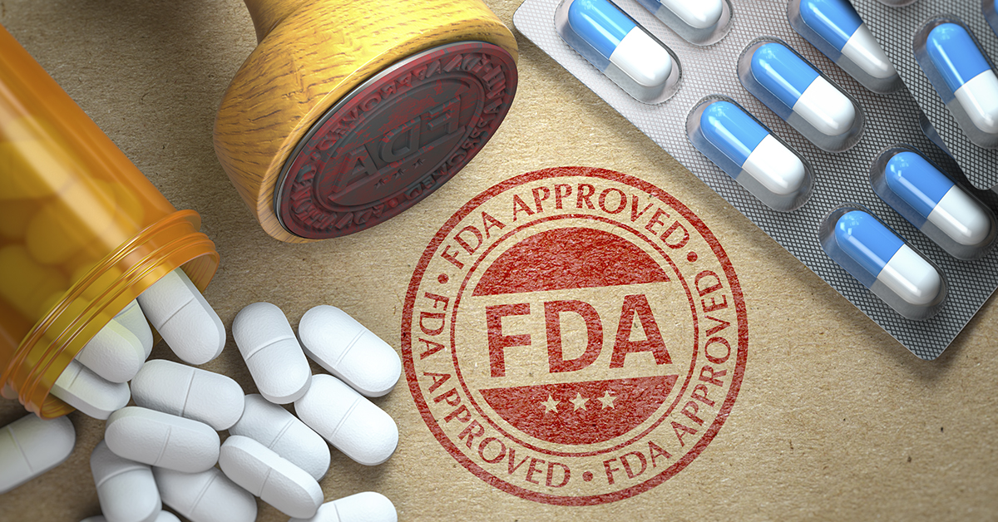
Which states had the most recalls by drug classification?

Slide 12
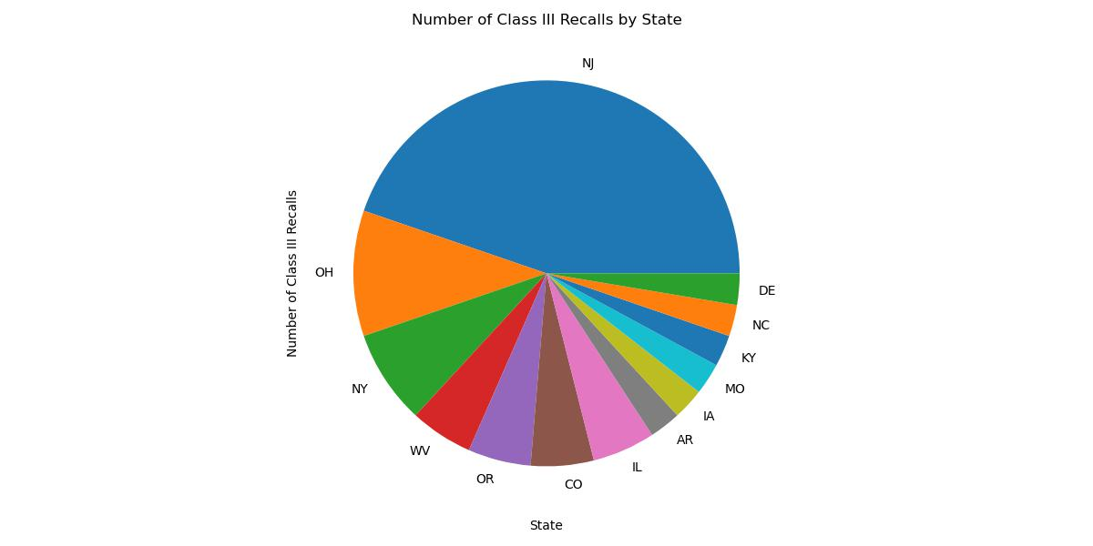

Slide 13
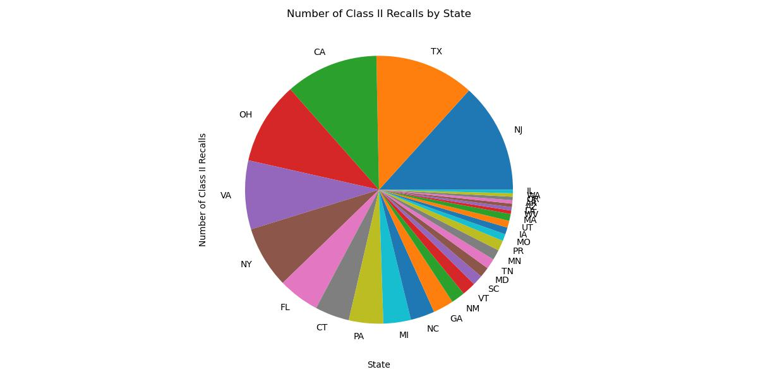

Slide 14
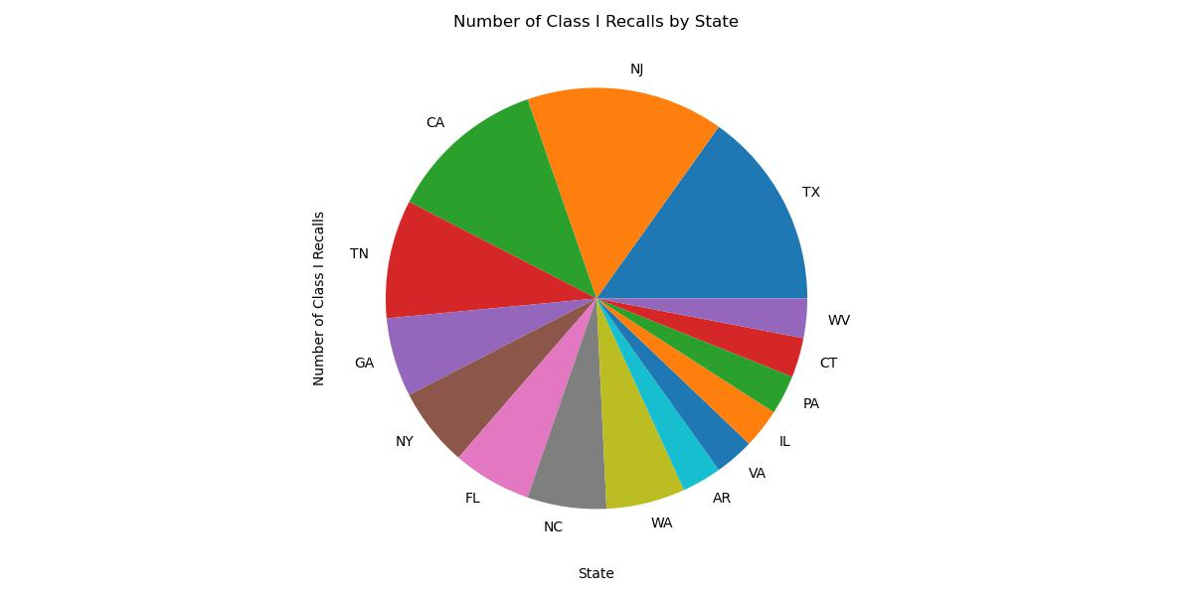

Slide 15
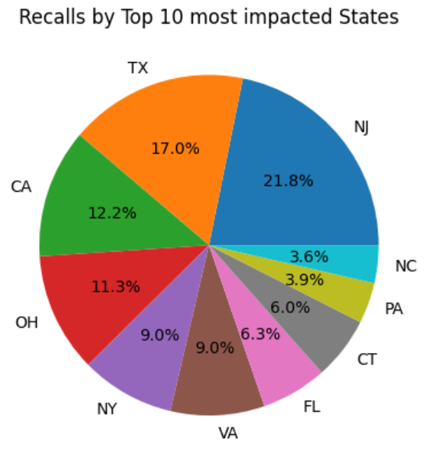
New Jersey, California, and Texas being impacted the most impacted states by these drug recalls

Slide 16
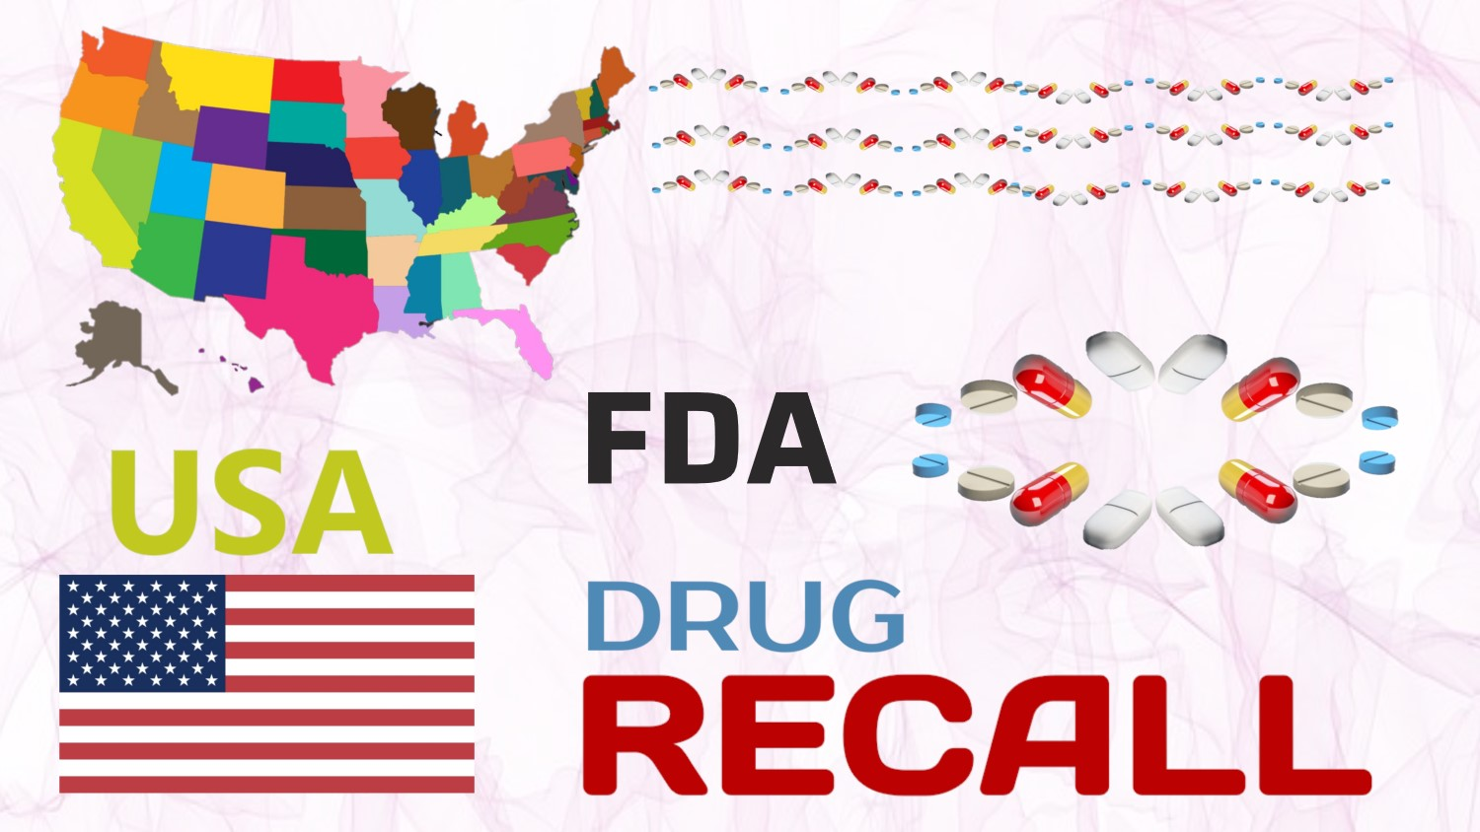
What is the average duration from the initiation to the termination of a drug recall?

Slide 17
The FDA drug recall process includes:
Initiation of the recall
Classification by risk level
Public notification
Correction or removal of affected products
FDA monitoring
Termination once the recall is complete

Slide 18
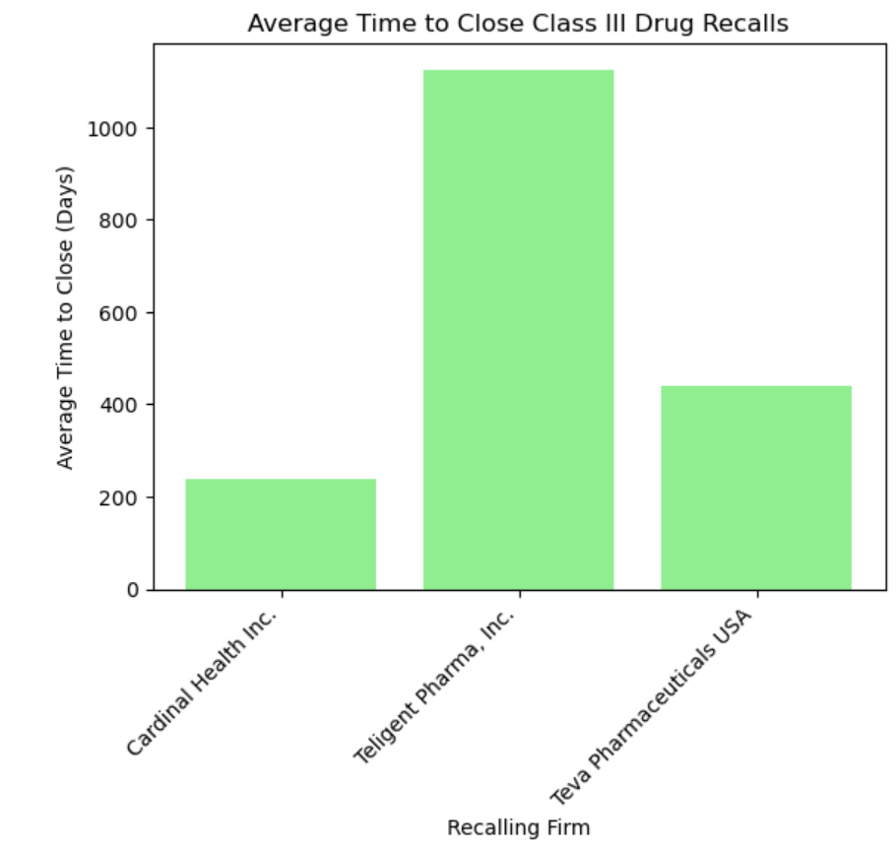

Slide 19
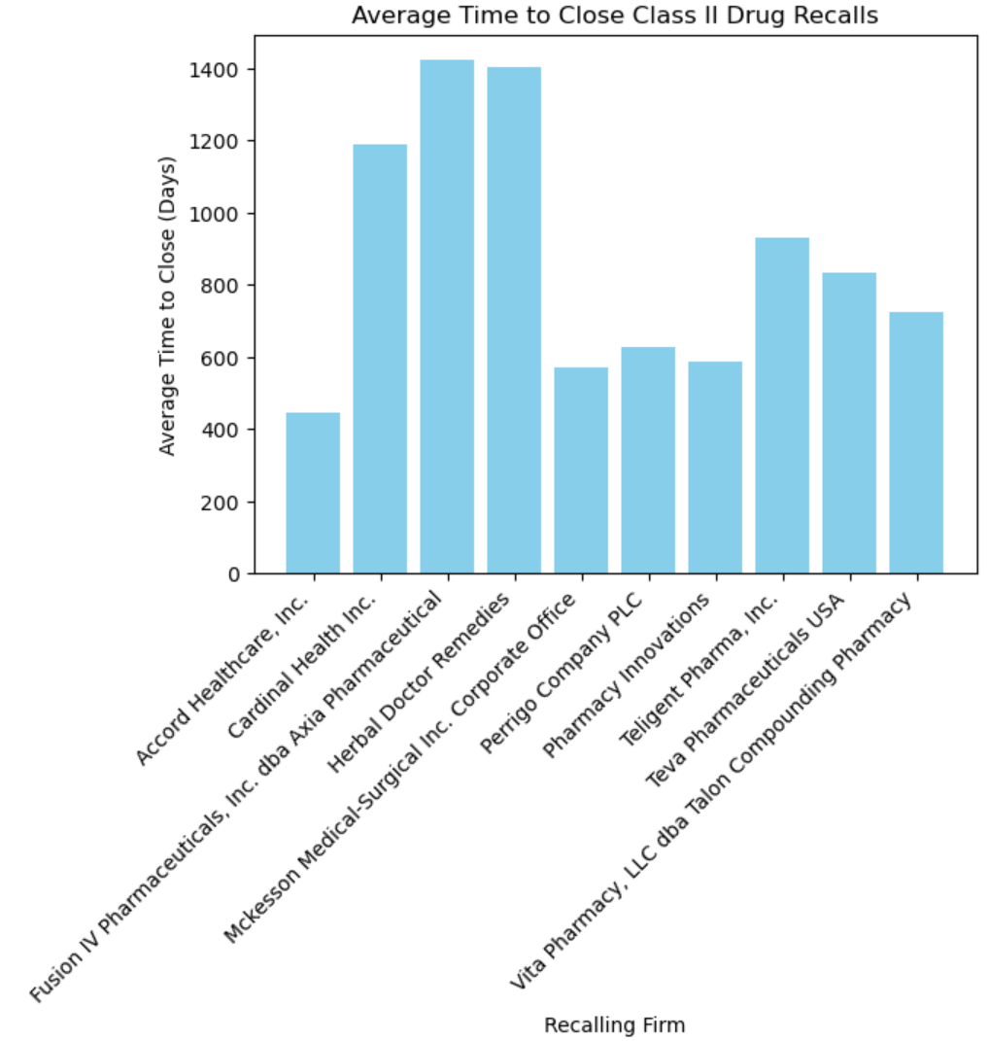

Slide 20
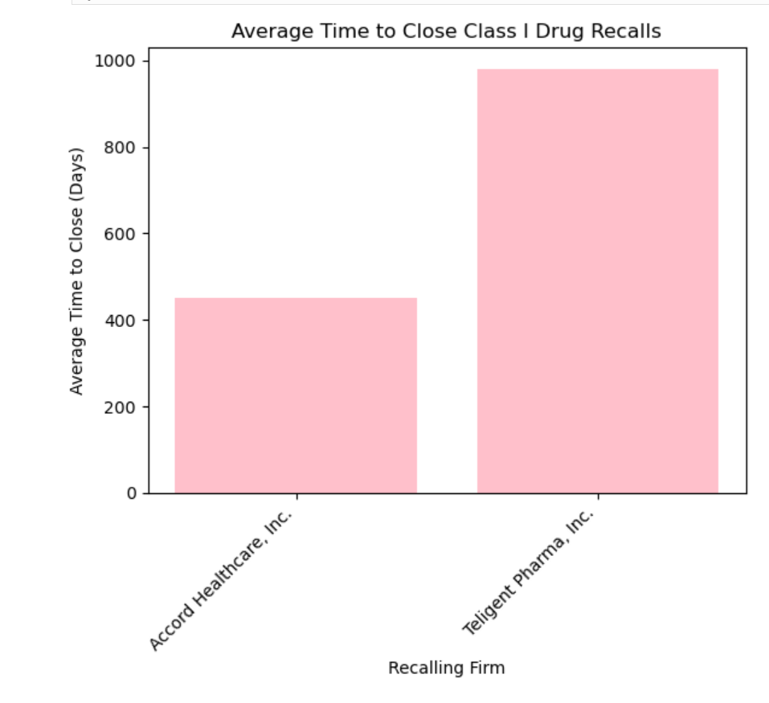

Slide 21
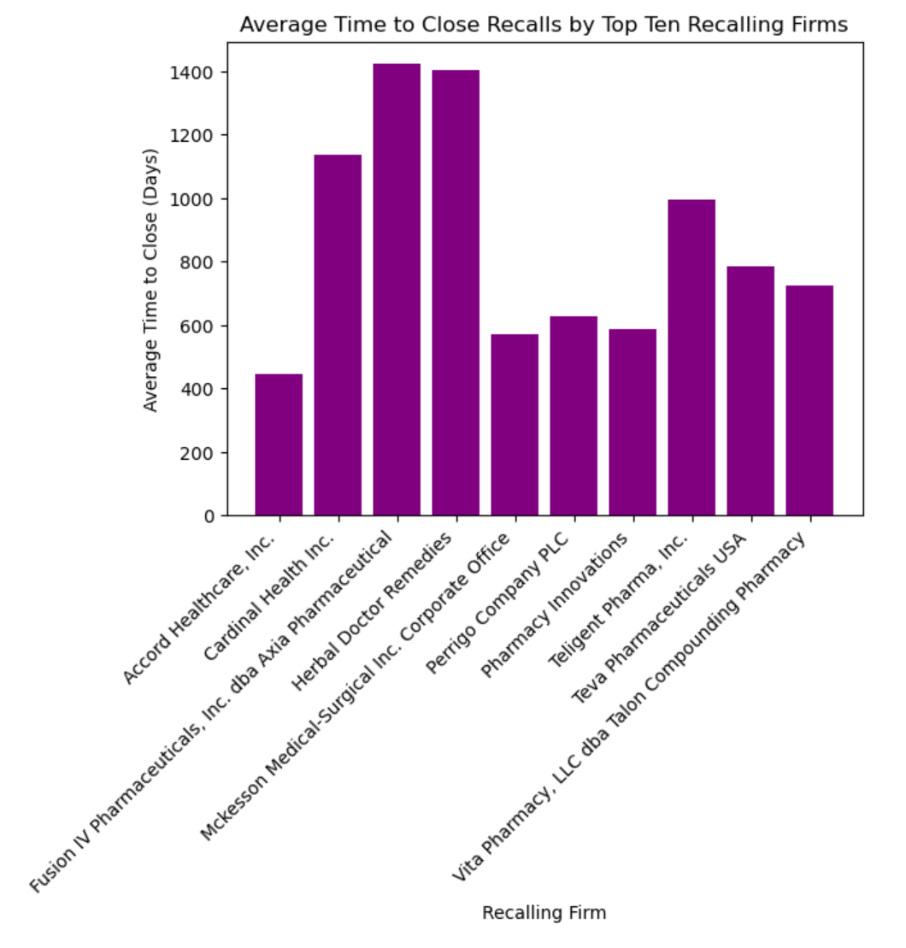
AvErage time to close recalls by top ten firms

Slide 22
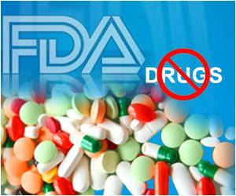
How does the Distribution of drugs that get recalled effect consumers globally?

Slide 23
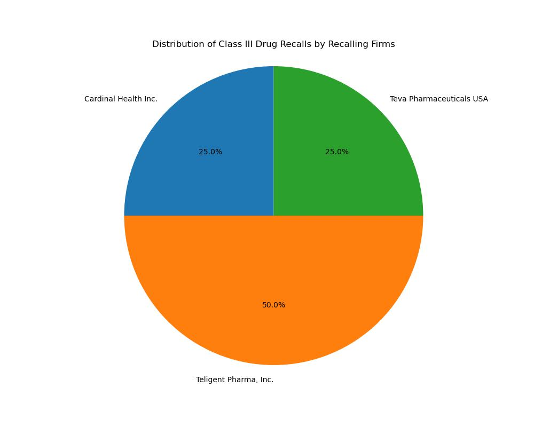

Slide 24
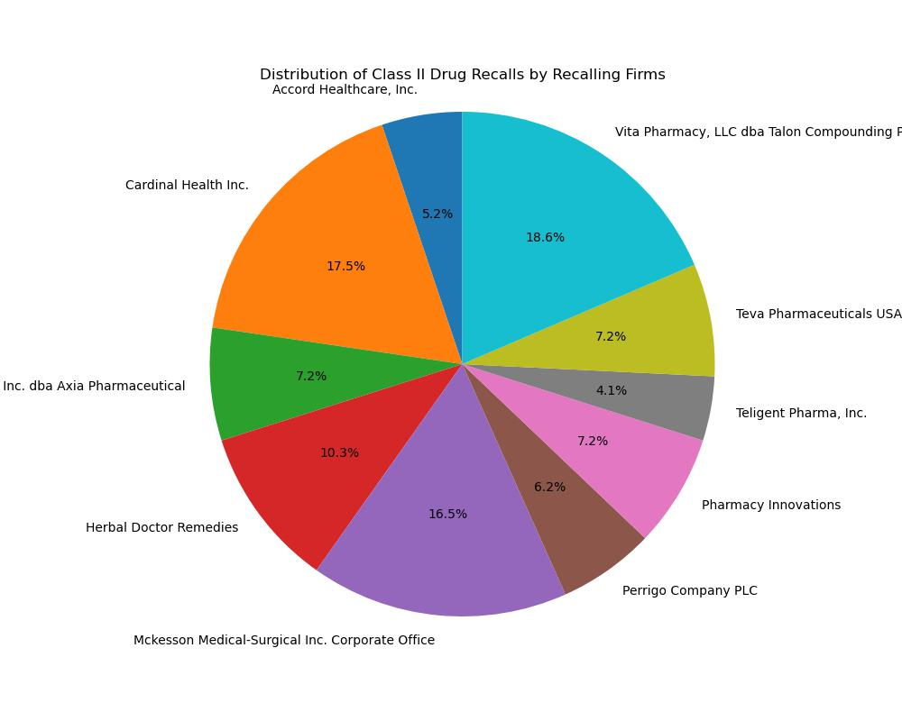

Slide 25
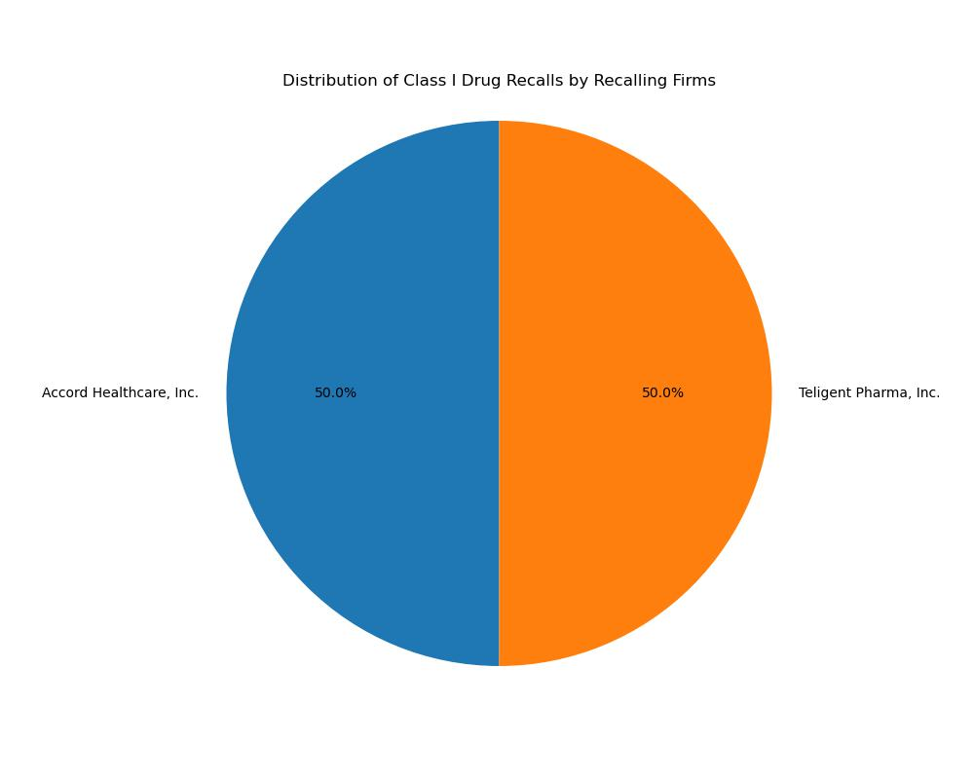

Slide 26
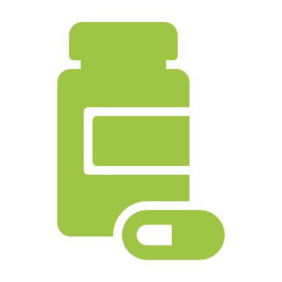
conclusion
FDA’s Critical Role: Protecting public health through stringent drug recall standards.
Class II Drug Recalls: Frequent recalls indicate ongoing quality control challenges, especially in widely prescribed drugs.
Importance of Regulatory Oversight: Highlights the need for continuous, vigilant oversight to ensure patient safety.
Growing Industry, Growing Responsibility: As the pharmaceutical sector expands, both regulatory vigilance and industry commitment are essential.
Patient Protection: Collaborative efforts between the FDA and firms are vital for minimizing risks and safeguarding public health.

Slide 27

Thank you for your attention and time today

